Slide 1


Welcome to Nepal
Nepal Tourism
The Beauty of Nepal

Slide 2
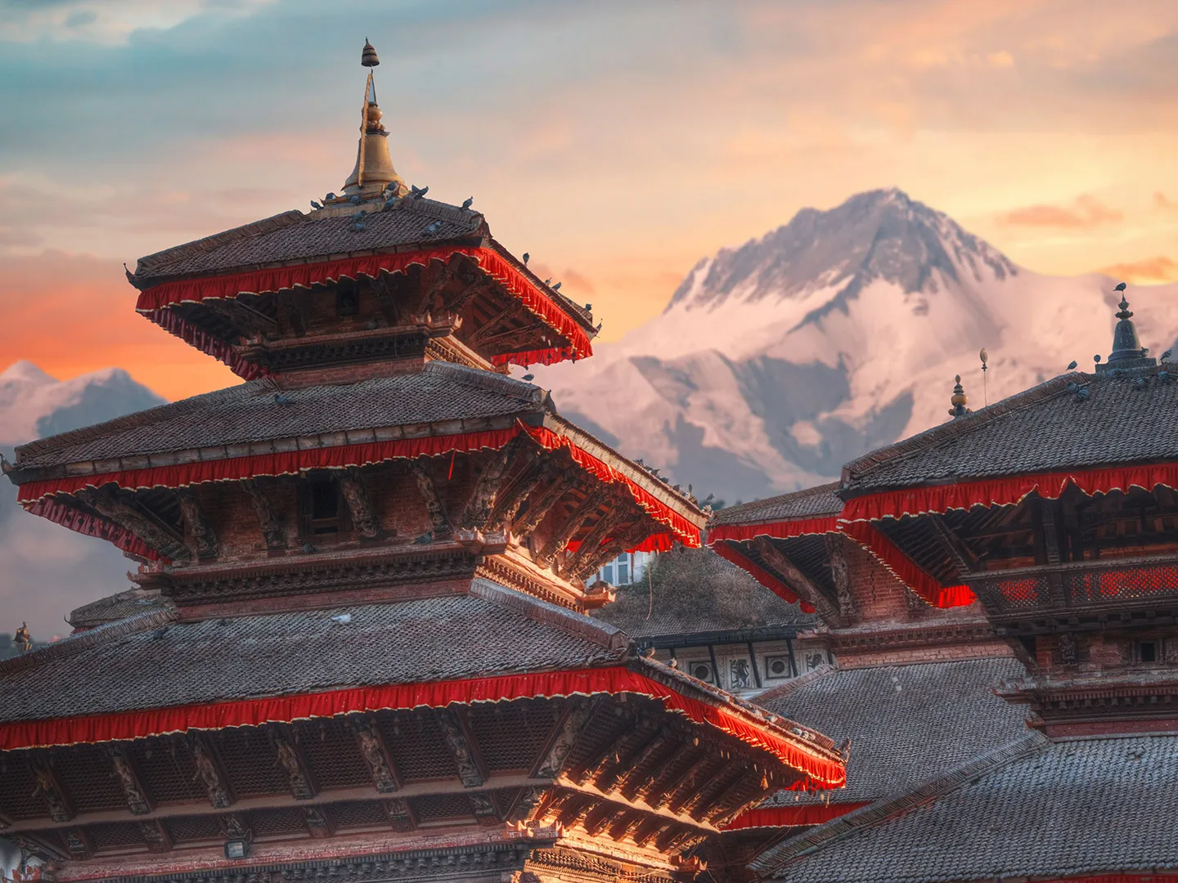
Kathmandu
Kathmandu, Nepal's captivating capital, is a vibrant blend of history, spirituality, and adventure. Explore ancient temples, intricate architecture, and bustling markets, immersing yourself in the city's rich cultural heritage. From sacred sites like Pashupatinath Temple to the serenity of Boudhanath Stupa, Kathmandu offers a spiritual journey like no other. Discover the royal charm of Durbar Square and embark on thrilling treks amidst breathtaking mountain vistas. Kathmandu is a destination that ignites the senses and leaves an indelible mark on every visitor.

Slide 3
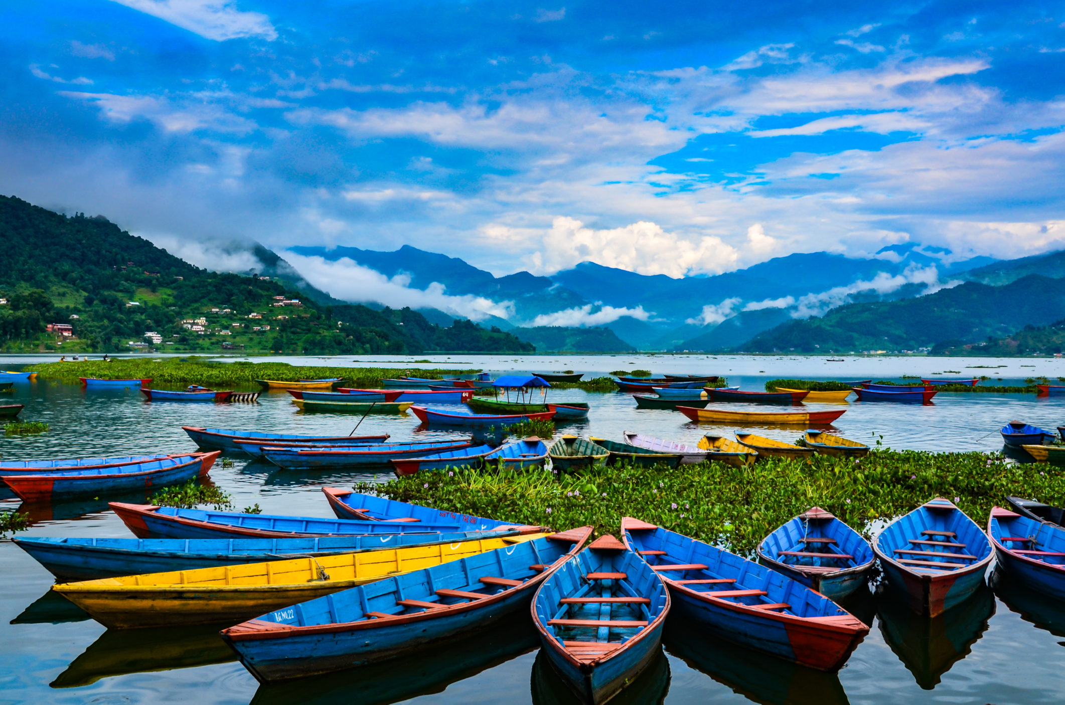
Pokhara
Picturesque city nestled in the lap of Himalayas
Offers breathtaking views of snow- capped mountains and serene lakes
Gateway to popular trekking destinations like Annapurna and mustang
Peaceful ambiance and natural beauty attract tourists and nature lovers
Phewa lake, the second largest lake in Nepal, major attraction for boating and relaxation
Sarangkot viewpoint provides stunning sunrise and sunset vistas
Adventure activities like paragliding and zip-lining for thrill-seekers
Rich cultural heritage showcased in historic temples and pagodas
Lively Lakeside area with a vibrant atmosphere and diverse dinging options and many more to places to visit

Slide 4
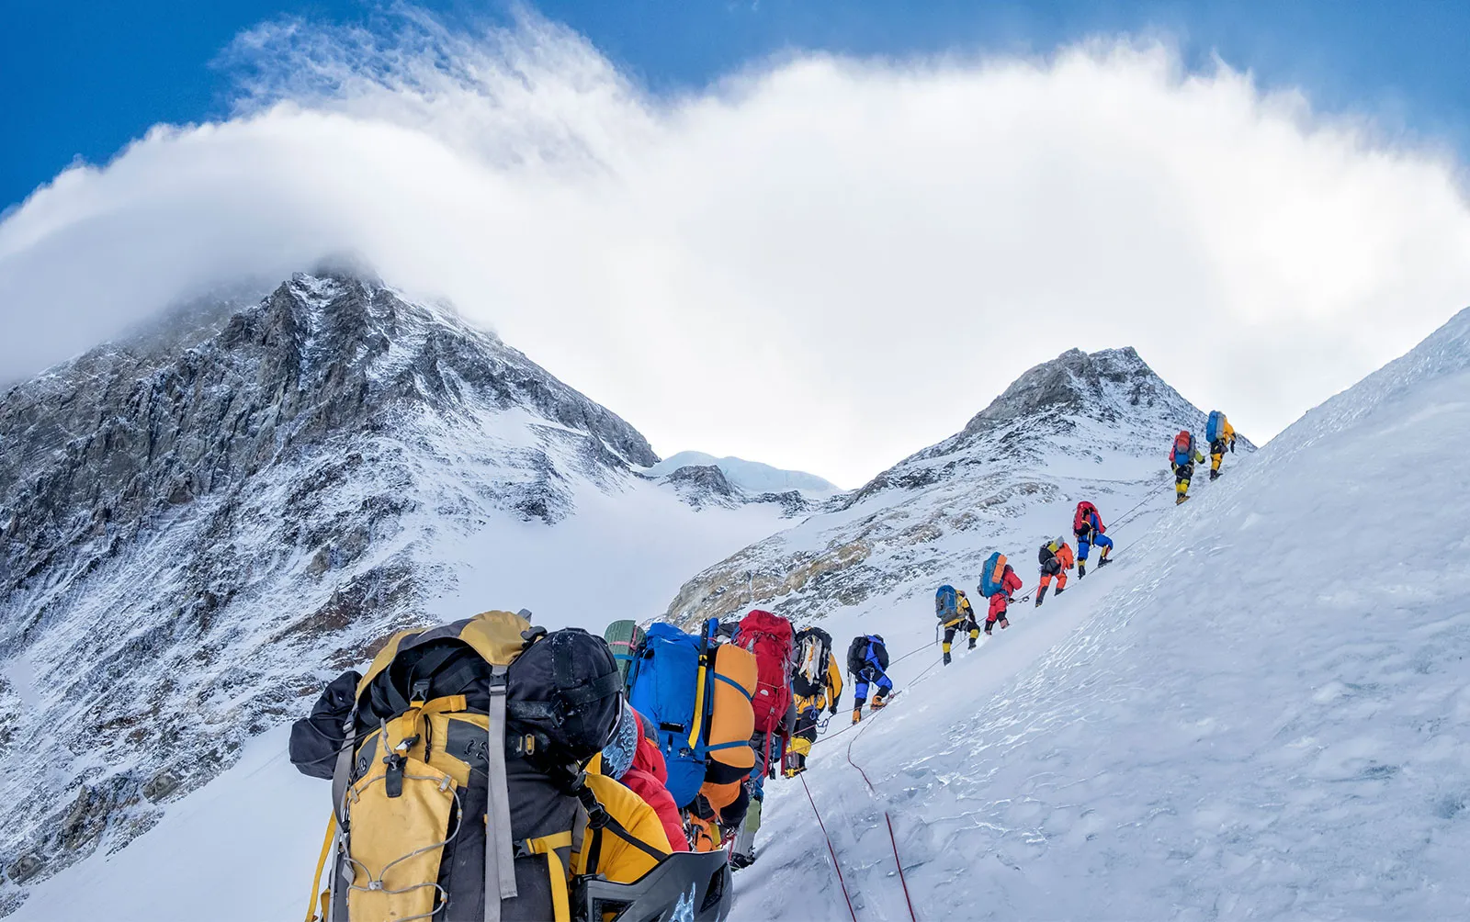
Mount Everest
Mount Everest, Nepal's prized gem, is a magnet for adventure enthusiasts seeking a thrilling and transformative experience. As the world's highest peak, it beckons travelers to embark on an unforgettable journey through Nepal's stunning landscapes. Trekking to Everest Base Camp and witnessing the mountain's majestic presence provides a profound connection with nature and a glimpse into the country's rich cultural heritage. Mount Everest stands as a symbol of Nepal's allure, inviting visitors to test their limits and create lifelong memories in the heart of the Himalayas.

Slide 5
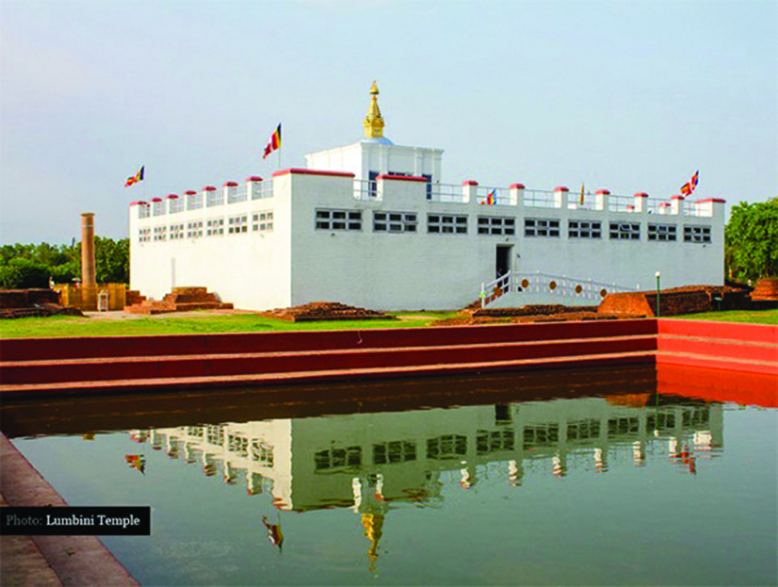
Lumbini
Lumbini, located in Nepal, holds a special place in the hearts of millions as the birthplace of Lord Buddha. This sacred site is home to the Maya Devi Temple, where Queen Maya Devi is believed to have given birth to Prince Siddhartha. The Ashoka Pillar, standing tall since ancient times, confirms Lumbini's historical significance. The serene Sacred Garden and Monastic Zone offer visitors a chance to explore beautiful gardens, monasteries, and immerse themselves in the diverse traditions of Buddhism from around the world. Recognized as a UNESCO World Heritage Site, Lumbini stands as a symbol of peace, spirituality, and a timeless connection to the teachings of the Buddha.

